Slide 1

Azure Functions
Event driven, compute-on-demand

Slide 2
Overview
What are Azure Functions?
How are they different and where do they fit
1
Triggers and Bindings
Simplify integration – Abstract away implementation details
2
Demos: Functions in C# and JavaScript
Develop, Debug, and Deploy
3
“Serverless” compute
Pay for what you use – Abstract away the server
4

Slide 3

Benefits
Pay for what you use
Let Azure Scale
Run small pieces of code
Focus on code
Easiest way to run your code in Azure!

Slide 4
Azure Functions Features
Choice of Languages
Choose the language that can best solve the problem. Mix-and-match
Simplified Integration
Integrate with Azure services and third-party services
Pay-per-use
Pay only for when your function executes
Open source
Runtime, scripting, VS tooling, and portal developed in the open in GitHub

Slide 5

“Frictionless”

Slide 6



App Service (PaaS)
Remote Debugging
Fully Managed
Scale Out
Scale Up
Monitoring
Language Support
Automated Scaling
App Settings
Kudu
VPN
Alerts
SSL
CORS
OAuth Authentication
ARM Deployment
Custom Domains
Continuous Integration
Backups
FTP
Deployment Slots
GitHub
VSTS
Web Deploy

Slide 7



Event-based Processing
Events
Code

Slide 8
What Kind of Events?
Manual | Schedule
Storage Queue | Storage Blob
Service Bus | Event Hub
HTTP | Webhooks
GitHub

Slide 9



Supported Languages
First-Class Support
Experimental Support
PowerShell
Python
PHP
Batch
Bash
Typescript

Slide 10
What Can You Build?
HTTP Backend
Integrate with third-parties
Web and Mobile backends
Webhook endpoints
Data Processing
Data Ingestion
Internet of Things (IoT)
Image Processing, Data Pipelines
Maintenance Task
Timer and manual execution
Clearing out old files
Index a database

Slide 11



Processing Pipeline
Manual
Queue
Http
Blob
Queue Trigger

Slide 12
Function Hosting Plans
App Service Plan
Consumption Plan
Select amount of resources (App Service Plan size)
Pre-determined pricing
You determine scaling (metric & threshold)
Pay for what you use
Platform determines scaling
“Traditional” App Service Plan
“Dynamic” Plan - Serverless

Slide 13
Azure Portal & Processing Pipeline
DEMO

Slide 14
Storage Queue
Durable message queueing
First In, First Out
Decouples application components
Polling

Slide 15
Processing Pipeline – Current Status
Queue
Manual
Queue Trigger

Slide 16
Storage Blob
Object storage for unstructured data
Massively-scalable
Geo-redundant
Hot or cool storage

Slide 17
Processing Pipeline – Current Status
Manual
Queue
Http
Blob
Queue Trigger

Slide 18
Supported Triggers & Bindings
Type | Service | Trigger | Input | Output
Schedule | Azure Functions | ✔
HTTP (REST or webhook) | Azure Functions | ✔ |  | ✔*
Blob Storage | Azure Storage | ✔ | ✔ | ✔
Queues | Azure Storage | ✔ |  | ✔
Tables | Azure Storage |  | ✔ | ✔
Tables | Azure Mobile Apps |  | ✔ | ✔
No-SQL DB | Azure DocumentDB |  | ✔ | ✔
Push Notifications | Azure Notification Hubs |  |  | ✔
Twilio SMS Text | Twilio |  |  | ✔
… more
* - The HTTP output binding requires an HTTP trigger

Slide 19
Local Development

Slide 20

Local Development: Visual Studio (Preview)
Pre-requisites
Visual Studio 2017 Preview 3
ASP.NET and web development, or
Azure development
Visual Studio 2017 Tools for Azure Functions extension

Slide 21
VS Development
DEMO

Slide 22
Serverless

Slide 23

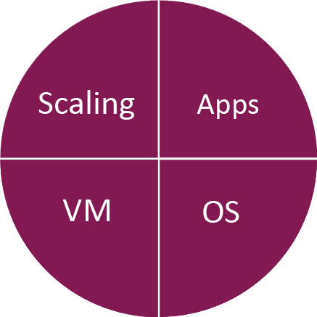
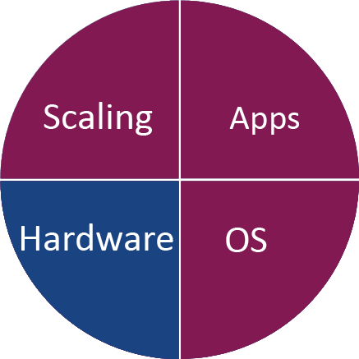
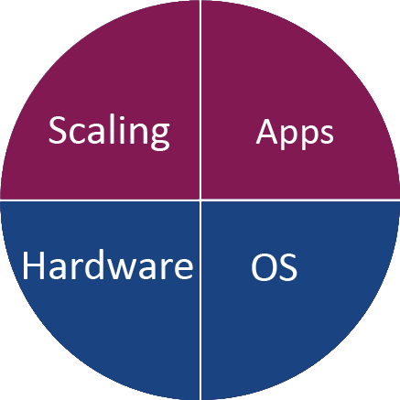
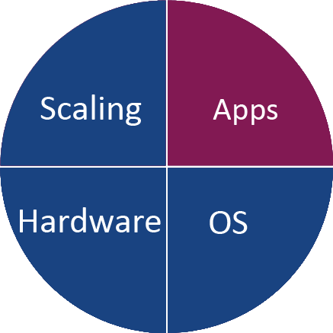
Evolution to Serverless
On-premises
servers
IaaS VMs
PaaS
Serverless

Slide 24
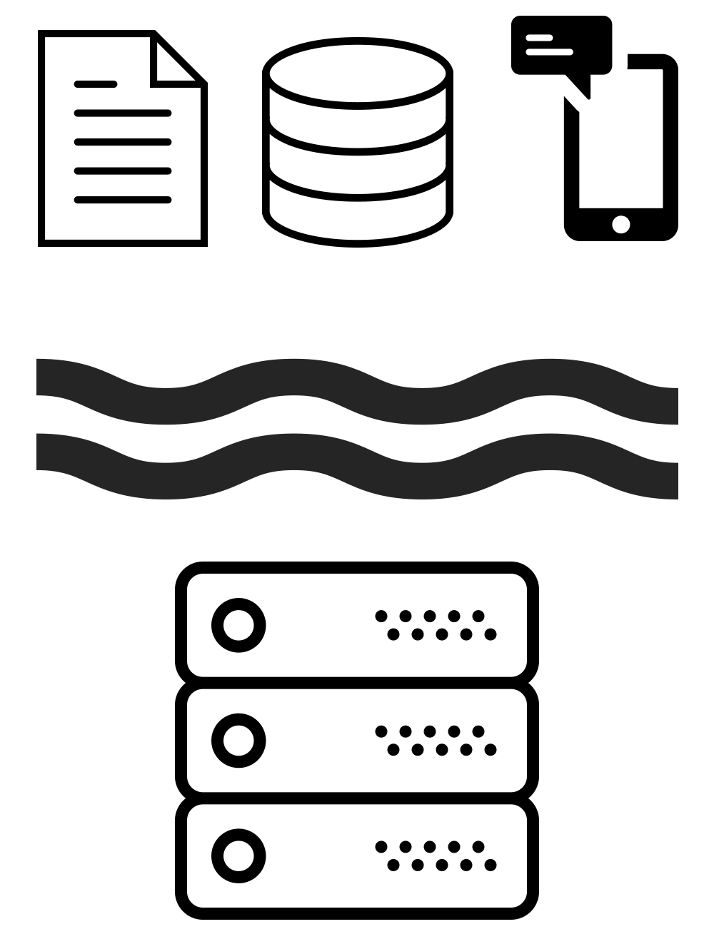
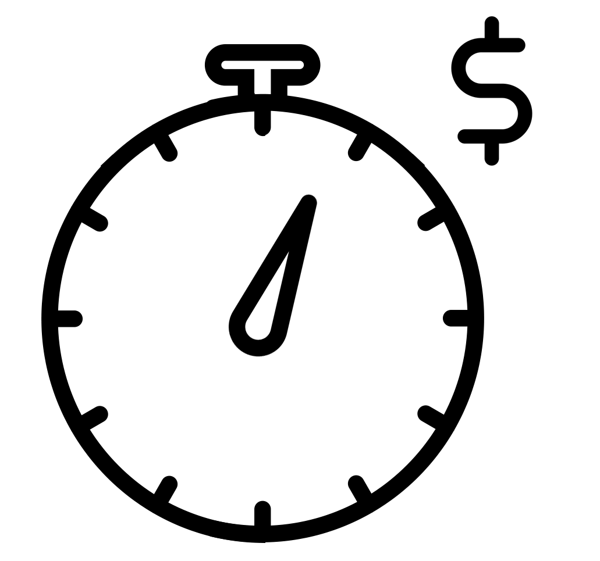

What is Serverless?
Abstraction of servers
Event-driven / instant scale
Sub-second billing

Slide 25
Scaling Out

Slide 26
Scaling Out an Azure Function
Function App
The unit of scale
Function App
Function App
Function App
ManualTrigger
HttpTrigger
QueueTrigger
ManualTrigger
HttpTrigger
QueueTrigger
ManualTrigger
HttpTrigger
QueueTrigger

Slide 27
App Service Plan Scaling
You will:
Need to have correct Service Plan
Basic – Manual
Standard or Premium – Automatic Scaling
Set up metric to trigger scaling by

Slide 28
Consumption Plan Scaling
Azure Functions will:
Monitor
Incoming events/requests
Amount of resources each function is taking
Automatically scale out
Provision additional VM instances as required

Slide 29
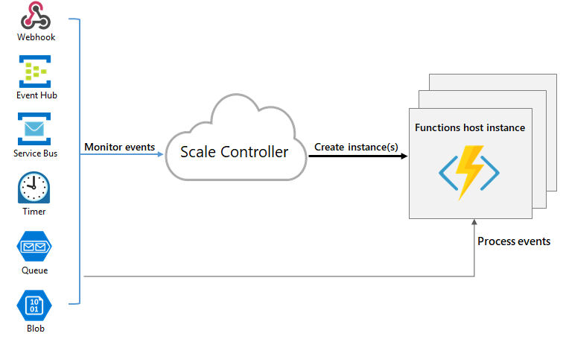
Scale Controller (Consumption Plan)
Source

Slide 30
Serverless
DEMO

Slide 31
“Servers when you want them,
serverless when you don’t”
Chris Anderson
PM, Microsoft Azure Functions

Slide 32
Pricing

Slide 33
Consumption Plan Pricing
Pay per execution model
Executions = Number of executions
GB-sec = Duration of execution x memory usage
Azure Functions price
$0.20/1M executions
$0.000016 /GB-sec

Slide 34
Consumption Plan Pricing
Free Grant
1,000,000 free executions
400,000 free GB-sec

Slide 35
Example pricing
Scenario: API Application
10 million requests a month
Average 0.5 sec execution duration
Average 512 MB memory usage
Math:
10M reqs * (0.5 sec * 0.5 GB) per request = 2.5M GB-sec
Billable units:
2.5M GB-sec – 400k GB-sec grant = 2.1M GB-sec ~= $33.60
10M requests – 1M free grant = 9M requests ~= $1.80

Slide 36
Best Practices

Slide 37
Chose one over the other
App Service Plan | Consumption
Plan on running often or continuously | One-off or once in a while - 10 minute limit
Have excess capacity on App Service | Don’t want to worry about setting scaling rules
Want predetermine cost | Don’t want to pay for an App Service Plan
> 15 MB file on HTTP Triggered | Maximum memory: 1.5GB

Slide 38
Best Practice
Avoid long-running functions
Use queues to communicate between functions
Queues, Topics, EventHub
Functions should be stateless
If need state, keep it in queue messages

Slide 39
Best Practice (cont.)
Write defensive functions
Allow for retry logic
Use dead-letter queues
Use async code

Slide 40
Dual Abstraction with Azure Functions
Serverless Abstraction
Abstract away the scaling of compute
1
Binding and Triggers
Abstract away the services you interact with
2

Slide 41
https://functions.azure.com/try
TRY IT

Slide 42
Questions?

